Slide 1
Introduction to LSTM

Slide 2
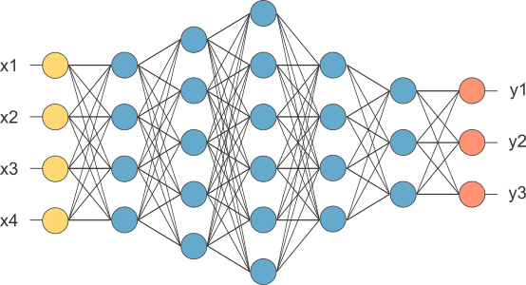
Fully Connected Network
This is our fully connected network. If x_{1 .}... x_{n}, n is very large and growing,
this network would become too large. We now will input one x_{i} at a time,
and re-use the same edge weights.

Slide 3
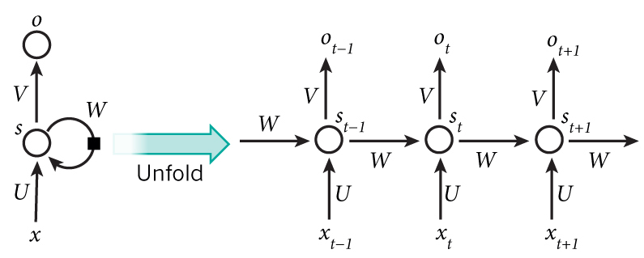
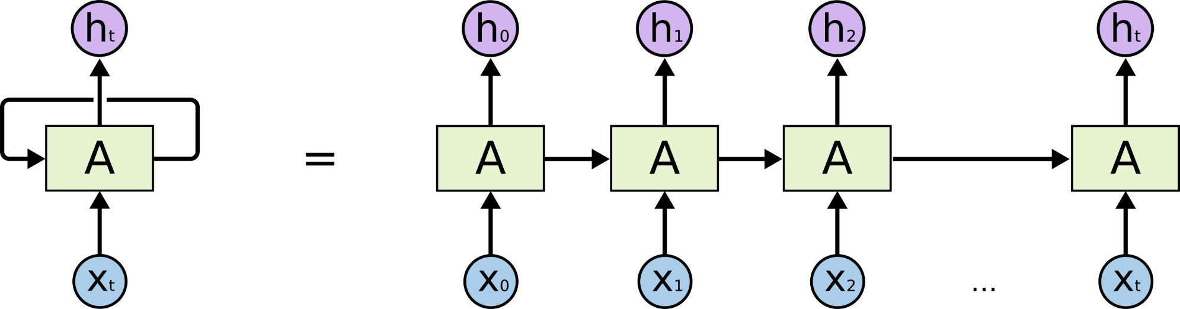
Recurrent Neural Network

Slide 4
How does RNN reduce complexity?
Given function f: h’,y=f(h,x)
h and h’ are vectors with the same dimension
y¹
y²
y³
h⁰
f
h¹
f
h²
f
h³
……
x¹
x²
x³
No matter how long the input/output sequence is, we only need one function f. If f’s are different, then it becomes a feedforward NN. This may be treated as another compression from fully connected network.

Slide 5

Deep RNN
h’,y = f₁(h,x), g’,z = f₂(g,y)
…
…
…
z¹
z²
z³
g⁰
f₂
g¹
f₂
g²
f₂
g³
……
y¹
y²
y³
h⁰
f₁
h¹
f₁
h²
f₁
h³
……
x¹
x²
x³

Slide 6
Bidirectional RNN
y,h=f₁(x,h)
z,g = f₂(g,x)
x¹
x²
x³
g⁰
g⁰
f₂
g¹
g¹
f₂
g²
f₂
g³
g²
g³
z¹
z²
z³
p¹
p²
p³
p²
p³
p=f₃(y,z)
f₃
f₃
f₃
y¹
y²
y³
h⁰
f₁
h¹
f₁
h²
f₁
h³
x¹
x²
x³

Slide 7
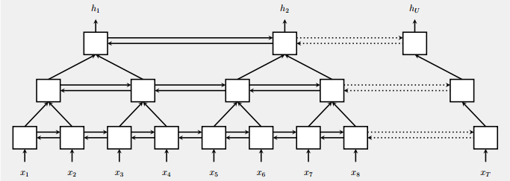
Pyramid RNN
Significantly speed up training
Reducing the number of time steps
Bidirectional
RNN
W. Chan, N. Jaitly, Q. Le and O. Vinyals, “Listen, attend and spell: A neural network for large vocabulary conversational speech recognition,” ICASSP, 2016

Slide 8
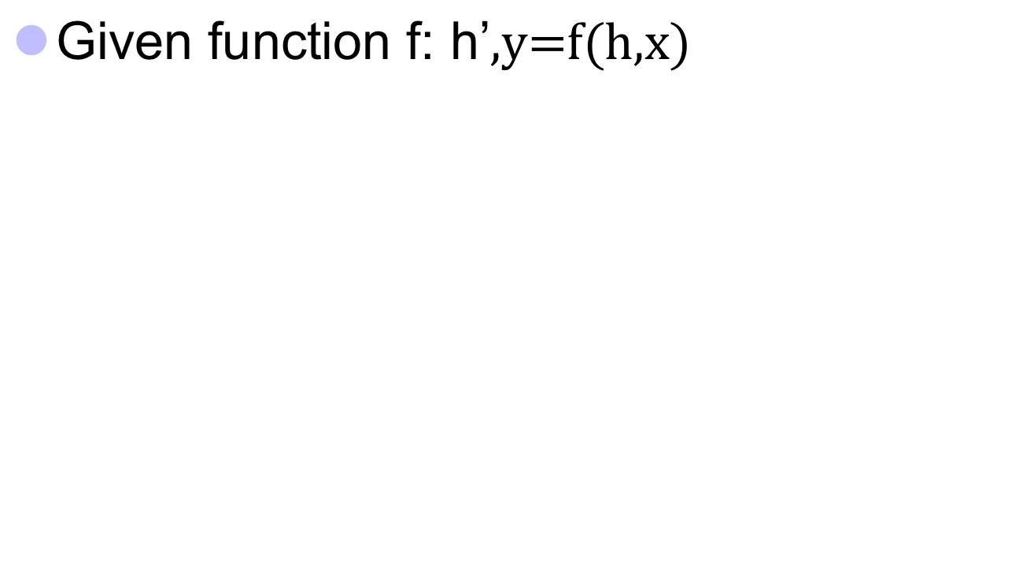



Naïve RNN
y
h'
W^{h}
^{h}
W^{i}
x
h
f
h'
y
Wº
^{h’}
Note, y is computed
from h’
x
softmax
We have ignored the bias

Slide 9
Problems with naive RNN
When dealing with a time series, it tends to forget old information. When there is a distant relationship of unknown length, we wish to have a “memory” to it.
Vanishing gradient problem.

Slide 10
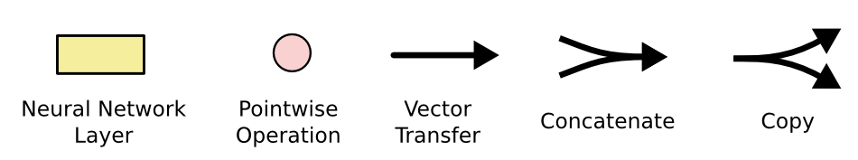
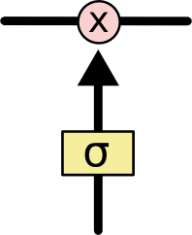
The sigmoid layer outputs numbers between 0-1 determine how much
each component should be let through. Pink X gate is point-wise multiplication.

Slide 11
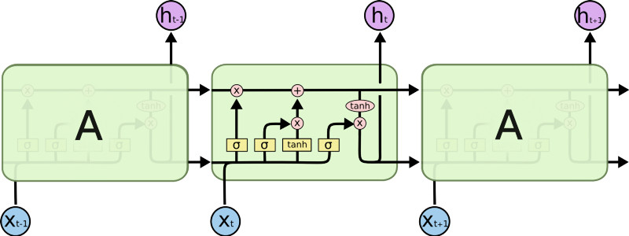
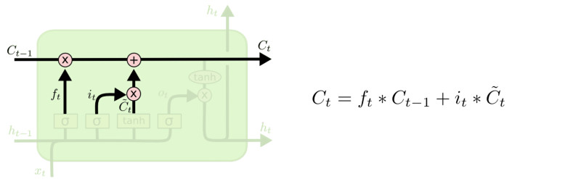
LSTM
Output gate
Controls what
goes into output
This sigmoid gate
determines how much
information goes thru
This decides what info
Is to add to the cell state
C_{t-1}
h_{t-1}
Forget input
gate gate
The core idea is this cell state C_{t}, it is changed slowly, with only minor linear interactions. It is very easy for information to flow along it unchanged.
Why sigmoid or tanh:
Sigmoid: 0,1 gating as switch.
Vanishing gradient problem in
LSTM is handled already.
ReLU replaces tanh ok?

Slide 12
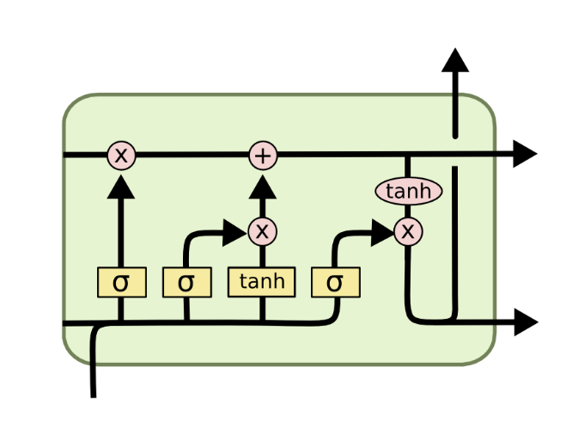
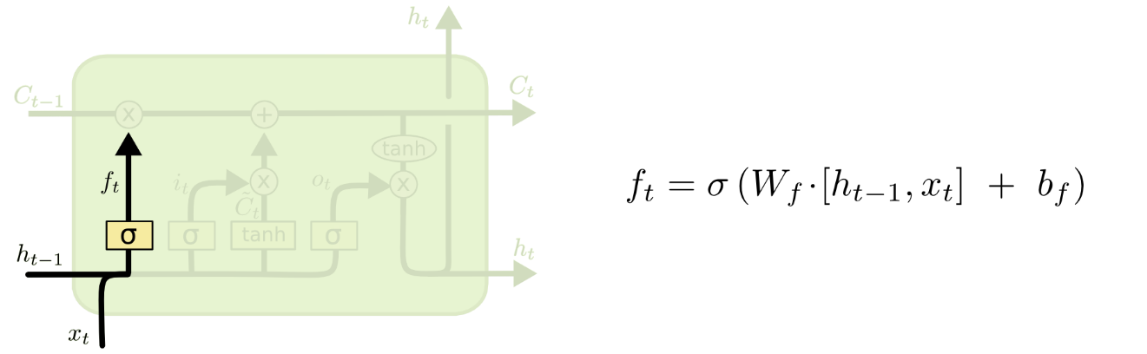
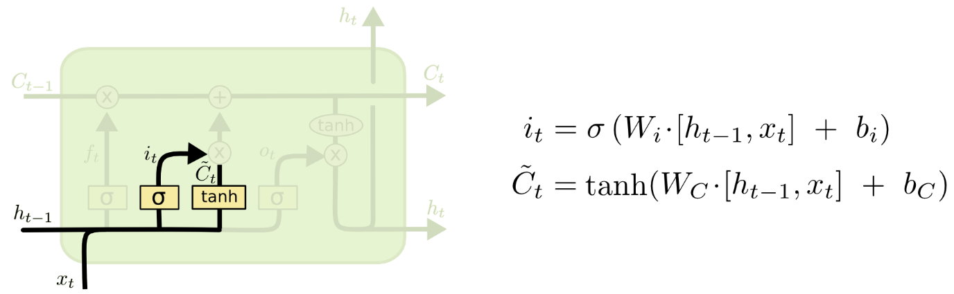
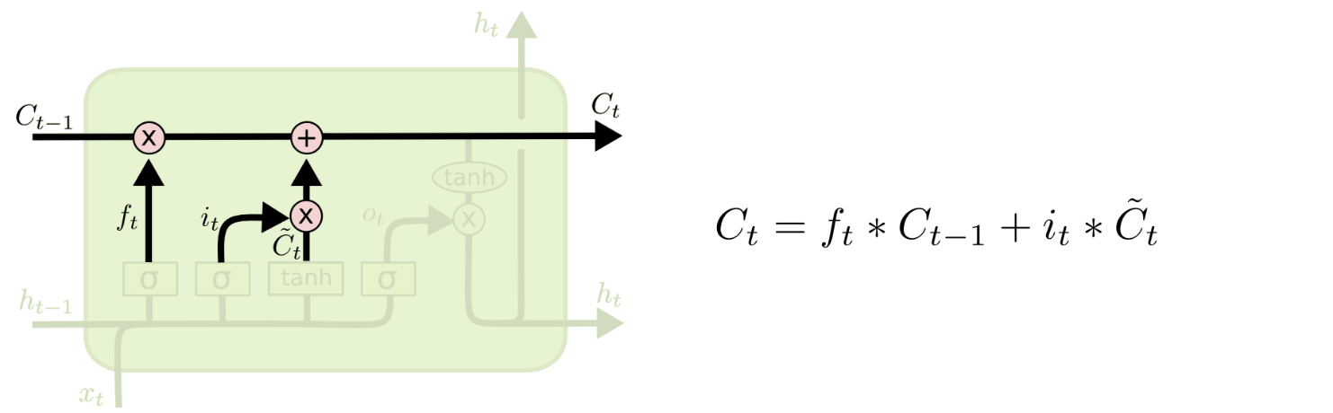
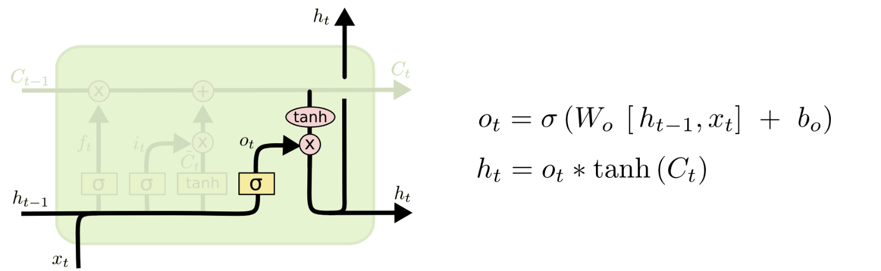
i_{t} decides what component
is to be updated.
C’_{t} provides change contents
Updating the cell state
Decide what part of the cell
state to output

Slide 13
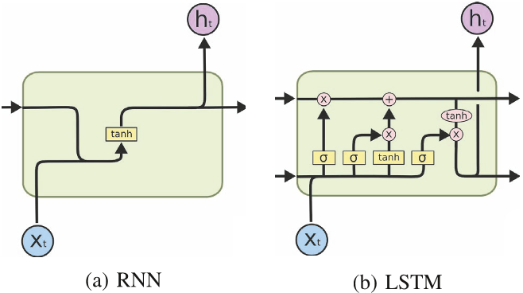
RNN vs LSTM

Slide 14
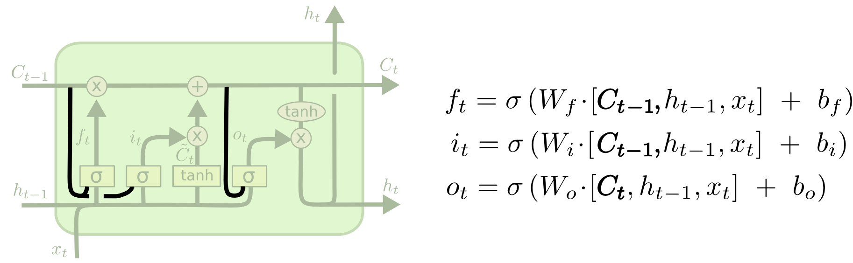
Peephole LSTM
Allows “peeping into the memory”

Slide 15
Naïve RNN vs LSTM
y^{t}
LSTM
c^{t}
y^{t}
c^{t-1}
Naïve
RNN
h^{t}
h^{t}
h^{t-1}
h^{t-1}
x^{t}
x^{t}
c changes slowly
c^{t} is c^{t-1} added by something
h changes faster
h^{t} and h^{t-1} can be very different

Slide 16
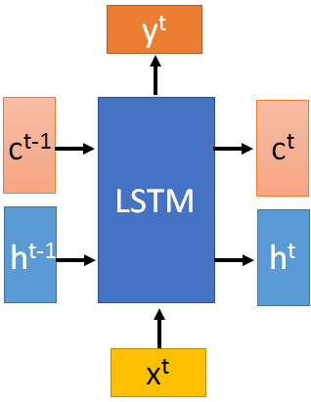

These 4 matrix
computation should
be done concurrently.
x^{t}
z
W
h^{t-1}
c^{t-1}
x^{t}
z^{i}
W^{i}
= σ( )
h^{t-1}
Controls
forget gate
Controls
input gate
Updating
information
Controls
Output gate
W^{f}
x^{t}
z^{f}
= σ( )
h^{t-1}
z^{f}
z^{i}
z
zº
x^{t}
zº
Wº
= σ( )
h^{t-1}
x^{t}
h^{t-1}
Information flow of LSTM

Slide 17
x^{t}
z
W
h^{t-1}
=tanh( )
c^{t-1}
c^{t-1}
diagonal
“peephole”
zº
z^{f}
z^{i}
obtained by the same way
z^{f}
z^{i}
z
zº
h^{t-1}
x^{t}
Information flow of LSTM

Slide 18




Element-wise multiply
y^{t}
c^{t-1}
c^{t}
c^{t} = z^{f}  c^{t-1} + z^{i}z
tanh
h^{t} = zº  tanh(c^{t})
y^{t} = σ(W’ h^{t})
z^{f}
z^{i}
z
zº
h^{t-1}
x^{t}
h^{t}
Information flow of LSTM

Slide 19



LSTM information flow
y^{t}
y^{t+1}
c^{t-1}
c^{t}
c^{t+1}
tanh
tanh
z^{f}
z^{i}
z
zº
z^{f}
z^{i}
z
zº
h^{t+1}
h^{t-1}
x^{t}
h^{t}
x^{t+1}
Information flow of LSTM

Slide 20
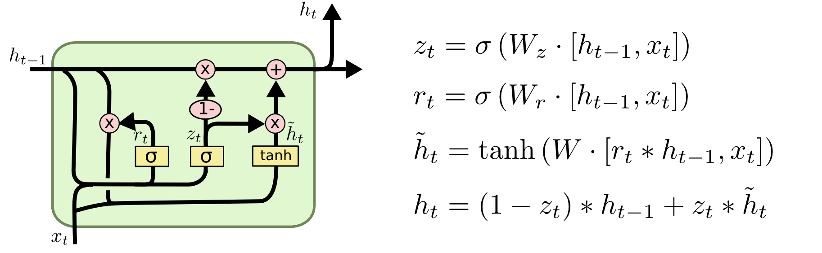
GRU – gated recurrent unit (more compression)
LSTM
reset gate
Update gate
It combines the forget and input into a single update gate.
It also merges the cell state and hidden state. This is simpler
than LSTM. There are many other variants too.
X,*: element-wise multiply

Slide 21
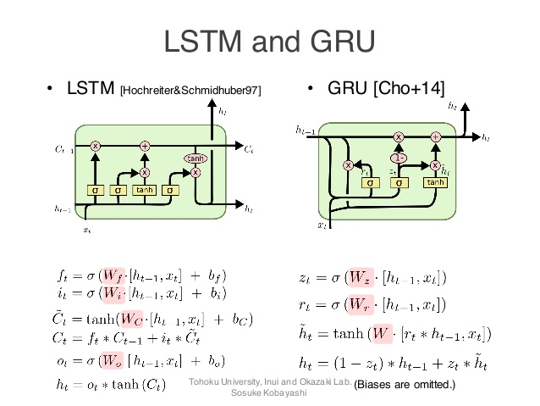
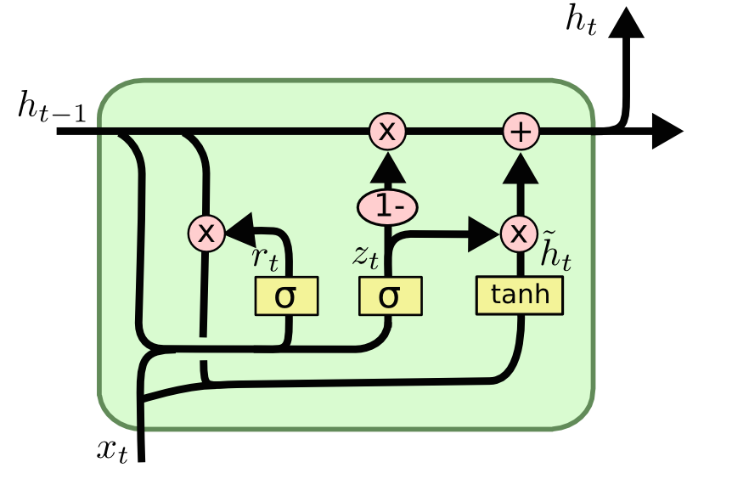
GRUs also takes x_{t} and h_{t-1} as inputs. They perform some calculations and then pass along h_{t}. What makes them different from LSTMs is that GRUs don't need the cell layer to pass values along. The calculations within each iteration insure that the h_{t} values being passed along either retain a high amount of old information or are jump-started with a high amount of new information.

Slide 22
Feed-forward vs Recurrent Network
1. Feedforward network does not have input at each step
2. Feedforward network has different parameters for each layer
x
f₁
a¹
f₂
a²
f₃
a³
f₄
y
t is layer
a^{t} = f_{t}(a^{t-1}) = σ(W^{t}a^{t-1} + b^{t})
h⁰
f
h¹
f
h²
f
h³
f
g
y⁴
x¹
x²
x³
x⁴
t is time step
a^{t}= f(a^{t-1}, x^{t}) = σ(W^{h} a^{t-1} + W^{i}x^{t} + b^{i})
We will turn the recurrent network 90 degrees.

Slide 23
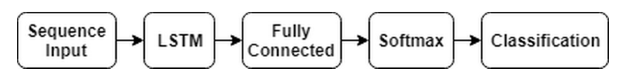
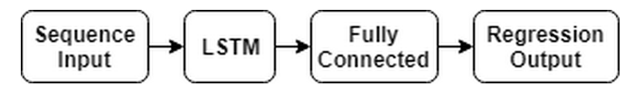
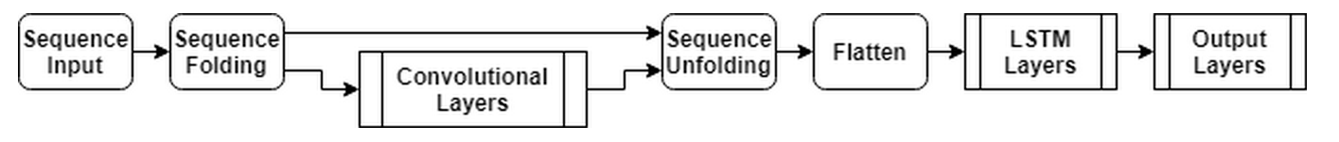
Applications of LSTM / RNN

Slide 24
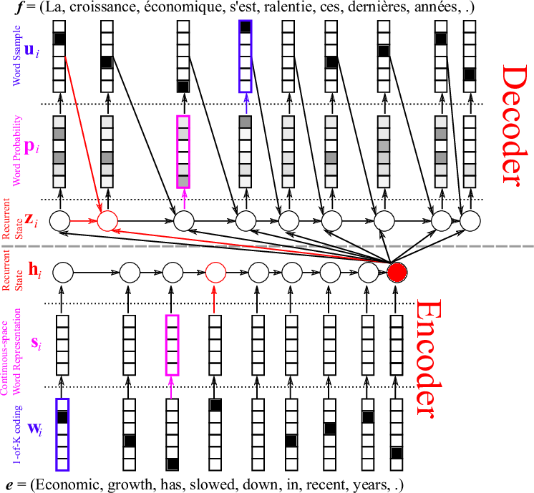
Neural machine translation
LSTM

Slide 25
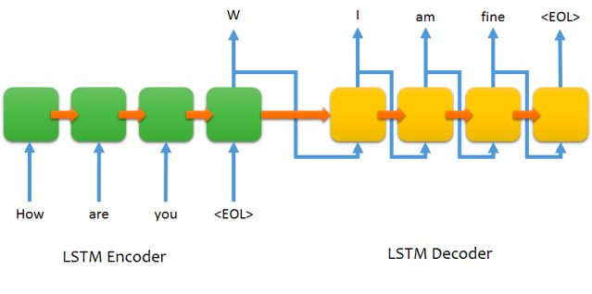
Sequence to sequence chat model

Slide 26

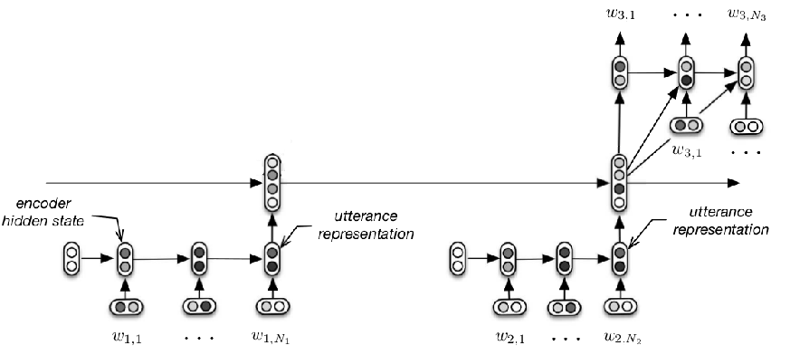
Chat with context
M: Hi
M: Hello
U: Hi
M: Hi
M: Hello
U: Hi
Serban, Iulian V., Alessandro Sordoni, Yoshua Bengio, Aaron Courville, and Joelle Pineau, 2015 "Building End-To-End Dialogue Systems Using Generative Hierarchical Neural Network Models.

Slide 27
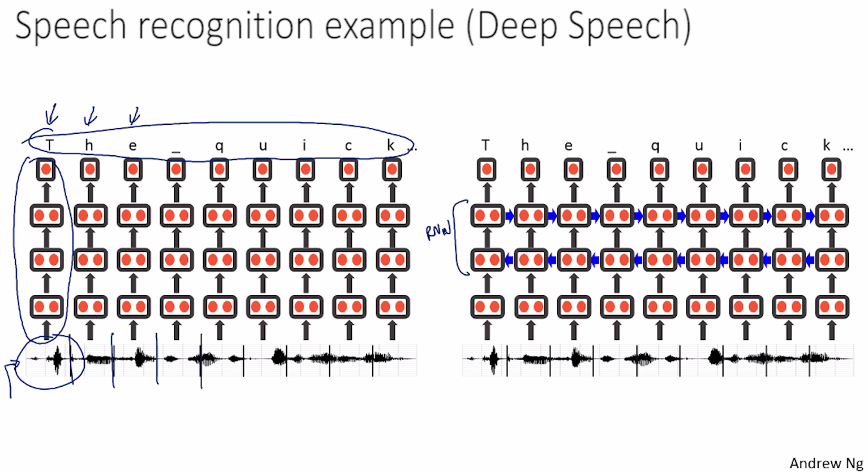
Baidu’s speech recognition using RNN

Slide 28
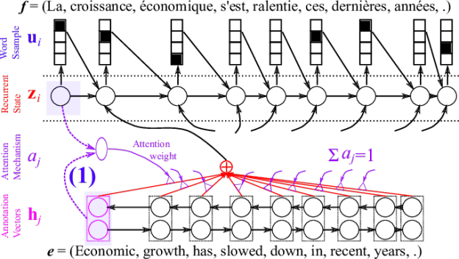
Attention

Slide 29
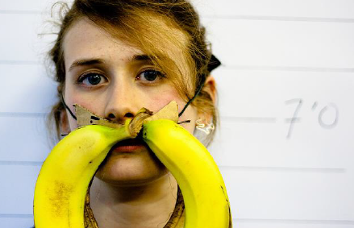
Image caption generation using attention (From CY Lee lecture)
A vector for each region
z⁰ is initial parameter, it is also learned
match
z⁰
0.7
CNN
filter
filter
filter
filter
filter
filter
filter
filter
filter
filter
filter
filter

Slide 30
Image Caption Generation
Word 1
A vector for each region
z⁰
z¹
Attention to
a region
weighted sum
CNN
filter
filter
filter
filter
filter
filter
0.7
0.1
0.1
0.1
0.0
0.0
filter
filter
filter
filter
filter
filter

Slide 31
Image Caption Generation
Word 1
Word 2
A vector for each region
z²
z⁰
z¹
weighted sum
CNN
filter
filter
filter
filter
filter
filter
0.0
0.8
0.2
0.0
0.0
0.0
filter
filter
filter
filter
filter
filter

Slide 32
Image Caption Generation
Kelvin Xu, Jimmy Ba, Ryan Kiros, Kyunghyun Cho, Aaron Courville, Ruslan Salakhutdinov, Richard Zemel, Yoshua Bengio, “Show, Attend and Tell: Neural Image Caption Generation with Visual Attention”, ICML, 2015
Notes:
Caption generation story like
How to do story like !!!!!!!!!!!!!!!!!!
http://www.cs.toronto.edu/~mbweb/
https://github.com/ryankiros/neural-storyteller

Slide 33
Image Caption Generation
Kelvin Xu, Jimmy Ba, Ryan Kiros, Kyunghyun Cho, Aaron Courville, Ruslan Salakhutdinov, Richard Zemel, Yoshua Bengio, “Show, Attend and Tell: Neural Image Caption Generation with Visual Attention”, ICML, 2015
Notes:
滑板相關詞
skateboarding
查看全部
skateboard
¹ Dr.eye譯典通
KK [ˋsket͵bord] DJ [ˋskeitbɔ:d]

Slide 34
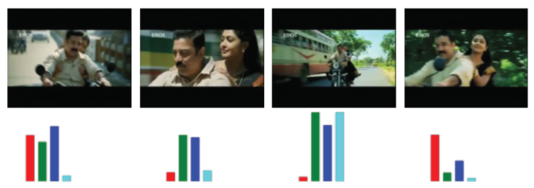
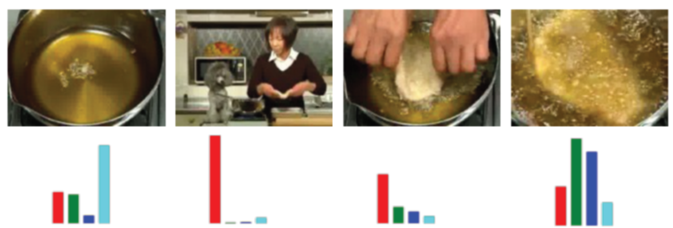

* Possible project?
Li Yao, Atousa Torabi, Kyunghyun Cho, Nicolas Ballas, Christopher Pal, Hugo Larochelle, Aaron Courville, “Describing Videos by Exploiting Temporal Structure”, ICCV, 2015
Notes:
Another application is summarization

Slide 35
Other Variations of LSTM

Slide 36
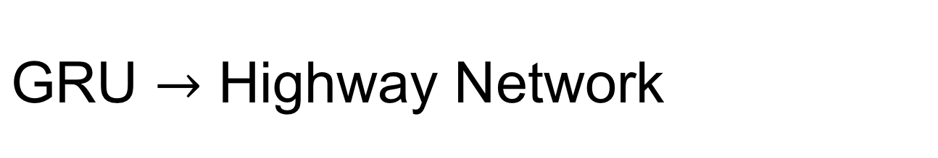

y^{t}
No input x^{t} at each step
a^{t-1}
a^{t}
h^{t-1}
h^{t}
No output y^{t} at each step
1-
a^{t-1} is the output of the (t-1)-th layer
reset
update
a^{t} is the output of the t-th layer
r
z
h'
No reset gate
a^{t-1}
h^{t-1}
x^{t}
x^{t}

Slide 37
h’=σ(Wa^{t-1})
Highway Network
z=σ(W’a^{t-1})
a^{t} = z  a^{t-1} + (1-z)  h
Highway Network
Residual Network
a^{t}
a^{t}
+
a^{t-1}
z controls red arrow
h’
h’
Gate controller
copy
copy
a^{t-1}
a^{t-1}
Training Very Deep Networks
https://arxiv.org/pdf/1507.06228v2.pdf
Deep Residual Learning for Image Recognition
http://arxiv.org/abs/1512.03385

Slide 38
output layer
output layer
output layer
Highway Network automatically
determines the layers needed!
Input layer
Input layer
Input layer

Slide 39
Highway Network Experiments

Slide 40
Grid LSTM
Memory for both time and depth
depth
y
a’
b’
LSTM
c’
Grid
LSTM
c’
c
c
h’
h’
h
h
x
a
b
time

Slide 41

Grid LSTM
h'
b'
a’
b’
c
c'
a
a'
Grid
LSTM
c’
tanh
c
h’
h
z^{f}
z^{i}
z
zº
a
b
h
b
You can generalize this to 3D, and more.

